Slide 1








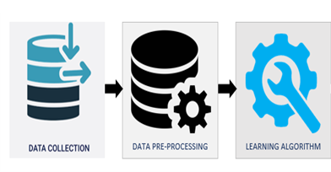
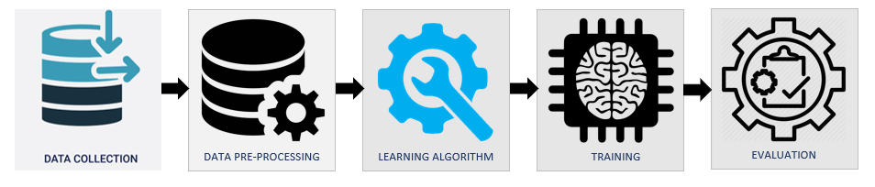
ARCHITECTURE
Modele.pkl
Scaler.pkl

